Slide 1

Nexthikes IT Solutions
Project-9
LLM Project:
Building a News Research Tool
Mahak Goyal

Slide 2
Project Overview
Goal
Automate news collection & summarization for equity research
Key Features
📡 Fetch latest news from APIs (NewsAPI / GNews)
🧠 Summarize content using LLMs (LangChain + OpenAI)
😀 Sentiment detection (Positive / Negative / Neutral)
💻 User-friendly Streamlit web interface

Slide 3
The Problem We Solve
🔴 Challenges
Manual news analysis is time-consuming
Too much data → information overload
Analyst reports often have subjective bias
🟢 Our Solution
AI-driven summarization of articles
Automated sentiment detection for faster insights

Slide 4
How It All Works
📌 Pipeline Overview 1 Data Source → NewsAPI / GNews 2 Processing → LangChain + LLM 3 Output → Summarized Insights 4 Frontend → Streamlit UI 5 Optional → Query logging, history, export
(Insert flowchart: NewsAPI → LangChain → Streamlit → User)

Slide 5
Getting Started (Environment Setup)
⚙️ Setup Requirements
Installed libraries: langchain, streamlit, newsapi-python, openai
API Keys: OpenAI + NewsAPI
Secure storage using .env file

Slide 6
Building the Brain (LangChain Setup)
📝 Content
Config file: langchain_config.py
PromptTemplate for summarization
LLMChain with OpenAI / Groq

Slide 7
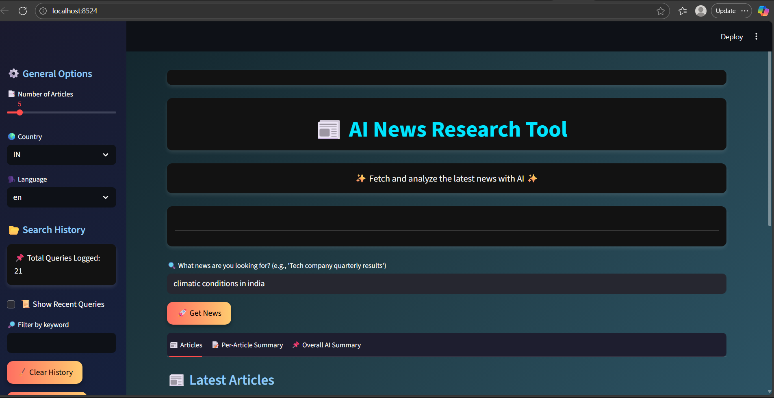
First Prototype (Basic App)
📝 Content
Created Streamlit app.py
Workflow: Query → Summary
Run with: streamlit run app.py

Slide 8

Bringing in Real News (NewsAPI Integration)
📝 Content
Connected to NewsAPI
Functions implemented:
Fetch articles
Extract descriptions
Combine summaries

Slide 9
Smarter Summaries (Enhanced Model)
📝 Content
Improved prompt: Query + Summaries
Generated overall article insights
Added sentiment analysis: ✅ Positive | ❌ Negative | ⚪ Neutral

Slide 10
Making Sure It Works (Testing & Validation)
📝 Core Content
✅ Pipeline tested end-to-end
📝 Verified query handling
📊 Checked relevance & accuracy of insights
⬜ Query works → ✅
⬜ Summarization runs → ✅
⬜ Sentiment detection correct → ✅
Query | Result
---------------------|-------------------
"Tesla stock news" | 5 articles → Summary ✅
"RBI policy update" | 3 articles → Insights ✅
"Random nonsense" | No relevant news → Handled gracefully ✅

Slide 11
Wrapping It Up (Documentation & Deployment)
📝 Core Content
📖 Code fully documented with comments
🗂 README & requirements.txt created
🏗 Project structure cleaned for deployment
🚀 Ready for real-world use
📦 AI NewsResearchTool
┣ 📜 app.py
┣ 📜 langchain_config.py
┣ 📜 requirements.txt
┣ 📜 README.md

Slide 12
What’s Next? (Enhancements)
🌟 Planned Features
🔐 User Authentication → secure access to authorized users
🎨 Better UI/UX → interactive Streamlit widgets, cleaner dashboards
📜 Query History & Export Options → save past searches, download insights
📊 Analytics Dashboard → visualize sentiment trends & article stats
“Which of these enhancements would YOU find most useful in your research workflow?”

Slide 13
🚀 Final Thoughts (Conclusion)
Delivered an AI-assisted equity research tool that fetches, summarizes, and analyzes news.
Key skills demonstrated: LangChain, Streamlit, APIs, LLMs, PDF generation.
Interactive features:
Per-article summaries and overall summary tabs
Sentiment detection (Positive / Negative / Neutral)
Downloadable PDFs for reports
Search history with filters and export options
Future Enhancements:
Multi-language support for global news
Financial trend detection and predictive insights
Advanced analytics dashboard with visualizations
User authentication and personalized experience

Slide 14
📚 References
LangChain Documentation – Building applications with LLMs https://www.langchain.com/docs/
NewsAPI – Fetching live news articles https://newsapi.org/docs
Streamlit Documentation – Building interactive Python apps https://docs.streamlit.io/
Python fpdf2 Library – PDF generation https://pyfpdf.github.io/fpdf2/
Medium Article: Building a News Summarizer with LLMs – Tutorial reference https://medium.com/@your-reference-link
Python Pandas Documentation – Data handling and CSV/Excel export https://pandas.pydata.org/docs/

Slide 15
Thank you

